Slide 1

HOCHSCHULE HAMM-LIPPSTADT · ELECTRONIC ENGINEERING · HARDWARE ENGINEERING
An FPGA-Based Roadside Unit Controller
Deterministic Intersection Reservation for Autonomous Vehicles
Group A7
Md Azadul Islam · Faysal Ahammed Tonmoy · MD Jubair Salehin Razin · MD Rafiul Islam
HW/SW Co-Design Seminar · Supervised by Prof. Dr. Achim Rettberg

Slide 2
OVERVIEW
Agenda
01
Motivation & Scenario
02
System Design
Why deterministic hardware arbitration matters
Requirements, interfaces, architecture, FSM
03
Implementation
04
Verification
VHDL controller & Nexys A7 FPGA prototype
QuestaSim simulation & test cases
05
Hardware Extension
06
Results & Outlook
Altium schematic & PCB layout concept
Validation summary, discussion, future work
2

Slide 3
INTRODUCTION
Coordinating Autonomous Vehicles at Intersections
North
Conventional intersections rely on traffic lights interpreted by human drivers.
Autonomous vehicles instead need digital permission from a Roadside Unit (RSU).
The RSU receives requests from four directions and issues conflict-free grants.
This work realizes that arbitration logic as deterministic FPGA hardware, in VHDL.
RSU
Critical
Zone
West
East
South
3

Slide 4



MOTIVATION
Three Governing Requirements
Safety
Priority
Determinism
Conflicting road groups must never receive a grant simultaneously.
The main road is served first whenever both road groups request access.
Timing behavior must be predictable, observable, and formally verifiable.
4

Slide 5

PROJECT OBJECTIVES
What the RSU Controller Must Achieve
Design a VHDL-based RSU controller for four-direction requests
Guarantee conflicting road groups never receive simultaneous grants
Group North + South as the main road; East + West as the side road
Verify behavior using QuestaSim waveform simulation
Grant main-road priority when both groups request access
Demonstrate the design on a Nexys A7 FPGA board
Serve the side road only when no main-road request is pending
Develop a schematic and PCB layout concept in Altium Designer
5

Slide 6


BACKGROUND
Technical Background & Related Work
FPGA & VHDL
Finite State Machines
Autonomous Intersection Mgmt.
Digital logic implemented directly as hardware gives cycle-accurate, predictable timing, simulated and verified before deployment [1],[2],[3].
FSMs decompose controller behavior into clear, testable operating modes — well matched to traffic arbitration [4].
Dresner & Stone's reservation-based framework formulates intersection access as a request-and-grant problem [5]; V2X links (IEEE 802.11p [6]) are a natural future extension.
6

Slide 7
SYSTEM DESIGN
Controller Architecture
Vehicle Request
Inputs
Request grouping logic combines four directional inputs into Main_req / Side_req.
The FSM arbitrates access and exchanges state/timing with the timer unit.
Grant output logic drives directional grants and LED / display debug outputs.
Request Grouping
Logic
FSM Controller
Timer Unit
Grant Output
Logic
LED / Display
Debug Outputs
7

Slide 8
SYSTEM DESIGN
Three-State Finite State Machine
MAIN
SERVICE
IDLE
No active request present.
MAIN_SERVICE
North/South grants follow N_req / S_req.
SIDE_SERVICE
East/West grants follow E_req / W_req.
main request
no request
IDLE
main req. /
timer expired
side req. /
timer expired
side request only
no request
SIDE
SERVICE
8

Slide 9
SYSTEM DESIGN
Safety Invariant & Timing
Timing Parameters
Mutual Exclusion
Parameter | Value | Meaning
MAIN_TIME | 20 | Main-road service window
SIDE_TIME | 10 | Side-road service window
tick_1s | 1 pulse | Timer update signal
Main-road and side-road grants are never asserted at the same time:
Main_grant ∧ Side_grant = 0
Main road served 2× longer than the side road, reflecting expected higher main-road volume. tick_1s is accelerated in simulation for compact, readable waveforms.
Enforced structurally: North/South grants are only reachable while the FSM occupies MAIN_SERVICE; East/West grants only while in SIDE_SERVICE. The invariant holds by construction.
9

Slide 10
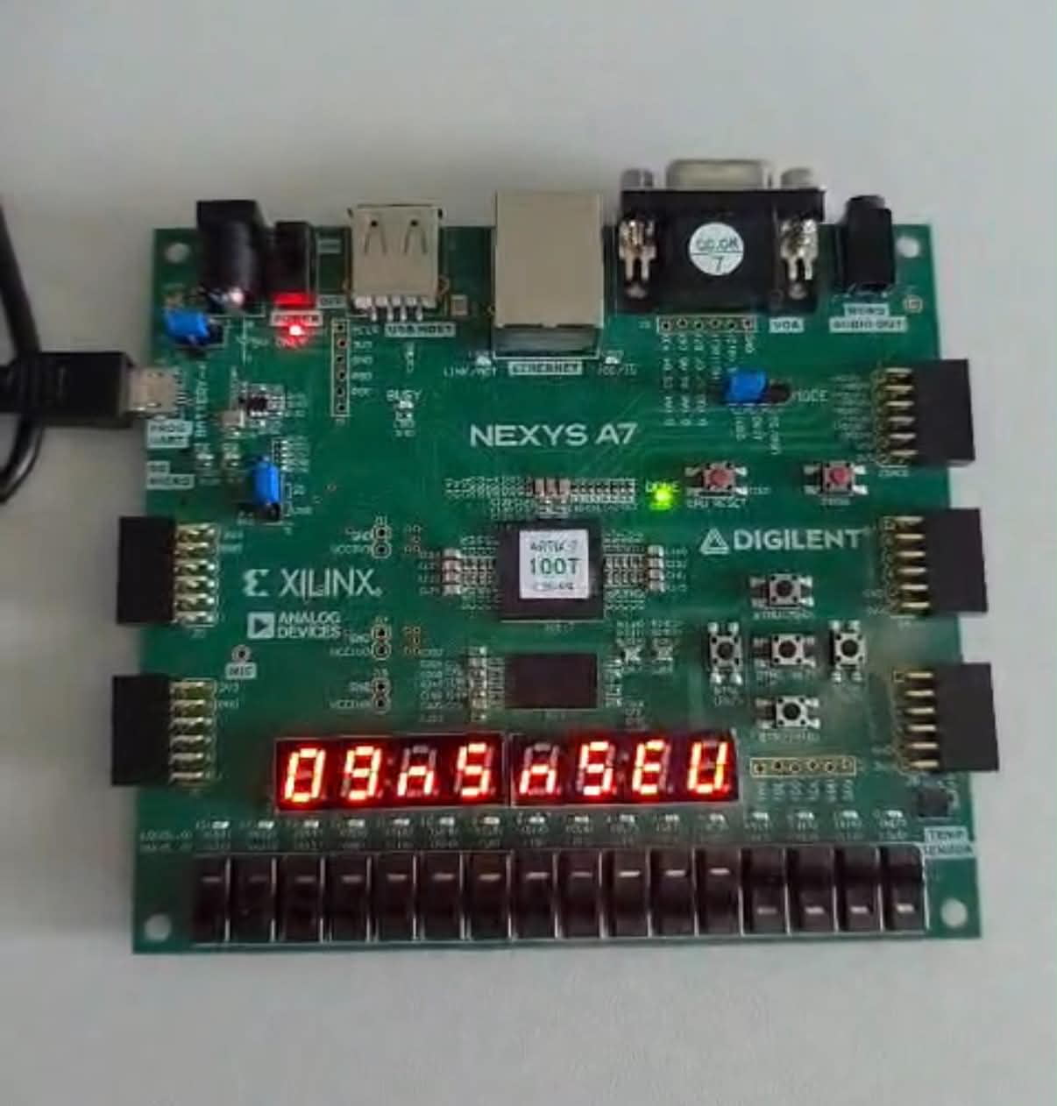
IMPLEMENTATION
FPGA Prototype on the Nexys A7
Xilinx Artix-7 FPGA board with on-board switches, LEDs, and seven-segment displays [7],[8].
Switches emulate the four directional vehicle requests.
LEDs present the corresponding grant outputs.
Seven-segment display shows road_code and countdown.
FPGA Element | Signal | Purpose
SW0 – SW3 | N_req, S_req, E_req, W_req | Directional vehicle requests
LED1, LED3 | N_grant, S_grant | Main-road grants
LED2, LED4 | E_grant, W_grant | Side-road grants
7-segment | road_code, countdown | Debug / status display
Nexys A7 board running the RSU controller
10

Slide 11
VERIFICATION
QuestaSim Verification Test Cases
A dedicated VHDL testbench applies six request scenarios and records grant outputs, FSM state, road code, and countdown for inspection.
TC | Input Condition | Expected Result
TC1 | No request | No grant active
TC2 | North/South request | Main-road grant active
TC3 | East/West request | Side-road grant active
TC4 | Main and side request together | Main road served first
TC5 | Timer expires while both groups request | Controller switches active road group
TC6 | Main and side grants checked jointly | Conflicting grants never occur together
11

Slide 12
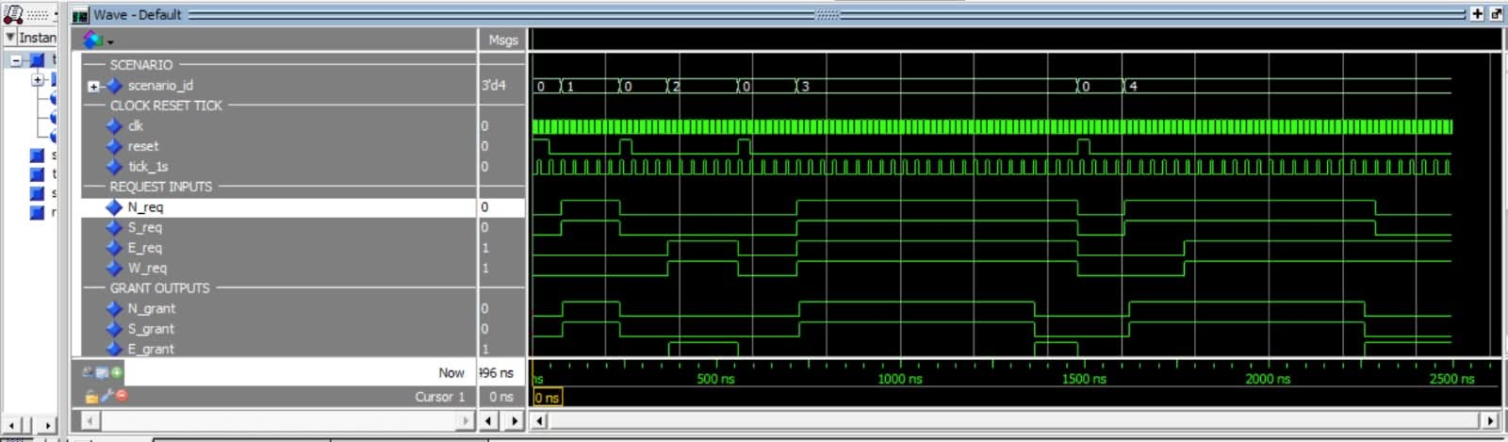
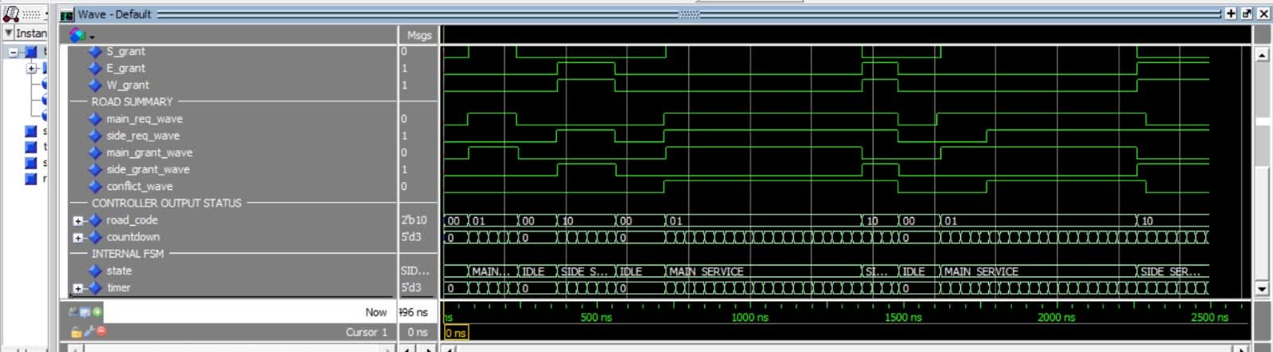
VERIFICATION
QuestaSim Waveform Evidence
Request inputs and grant outputs across the simulated traffic scenarios (scenario_id).
road_code (00 idle · 01 main · 10 side), countdown, and internal FSM state. Main- and side-road grants are never observed active simultaneously.
12

Slide 13
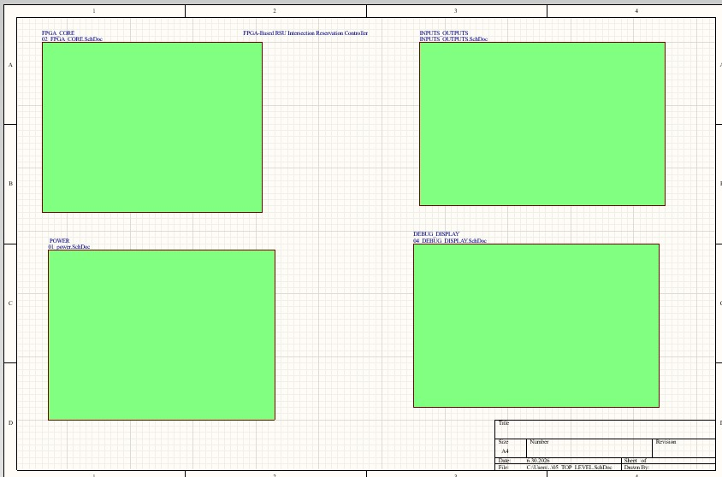
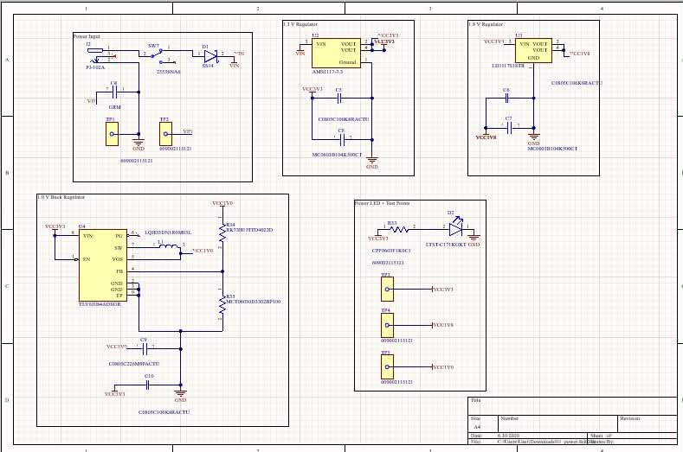
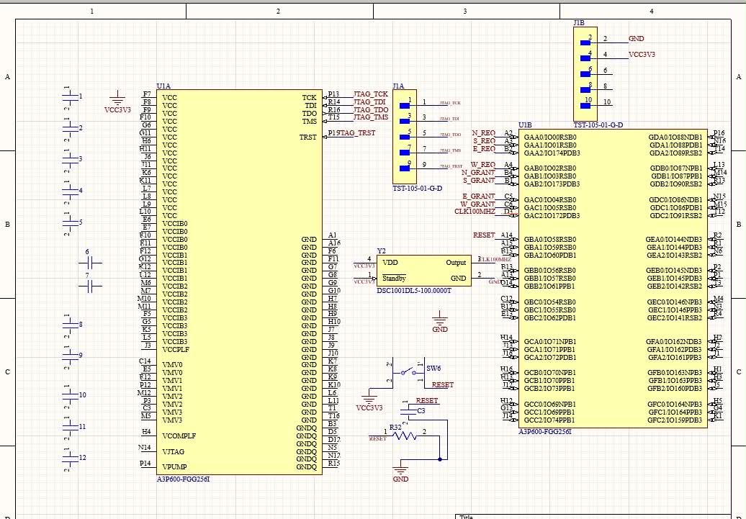
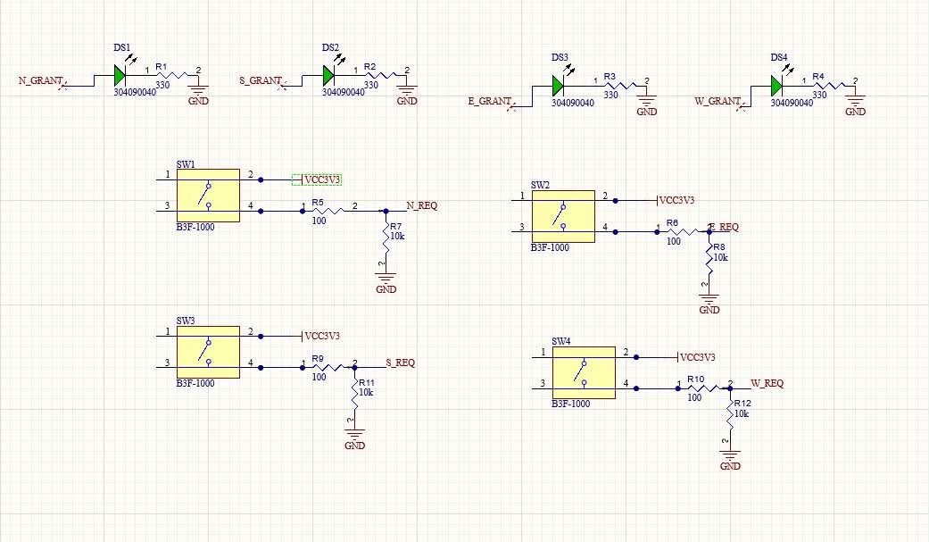
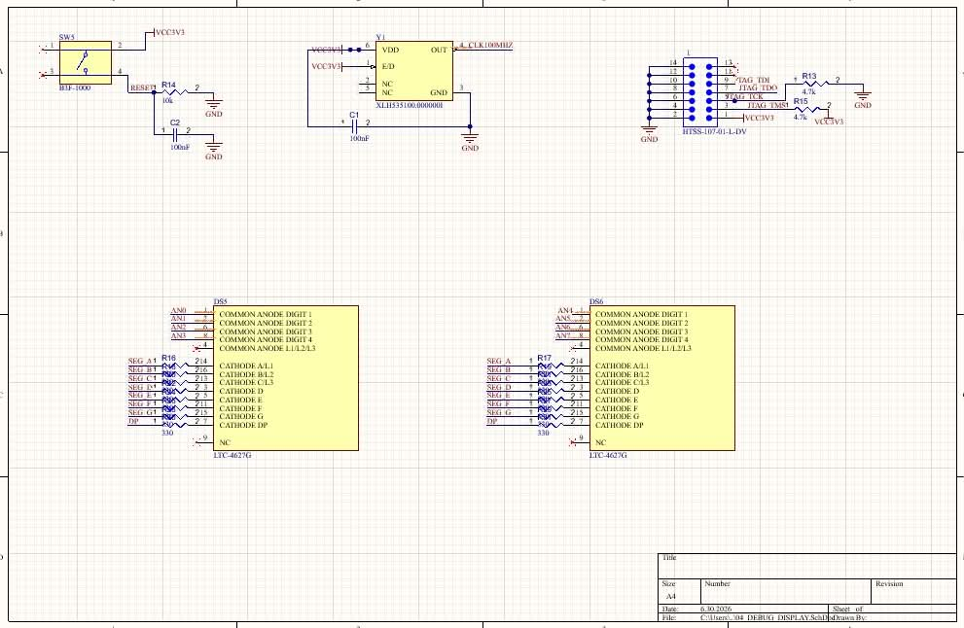
HARDWARE EXTENSION
Hierarchical Schematic Design (Altium)
Top-Level
Power Supply
FPGA Core
Five sheets connected via a top-level hierarchical schematic — power, FPGA core, I/O, and debug display [9].
Input / Output
Debug Display
13

Slide 14
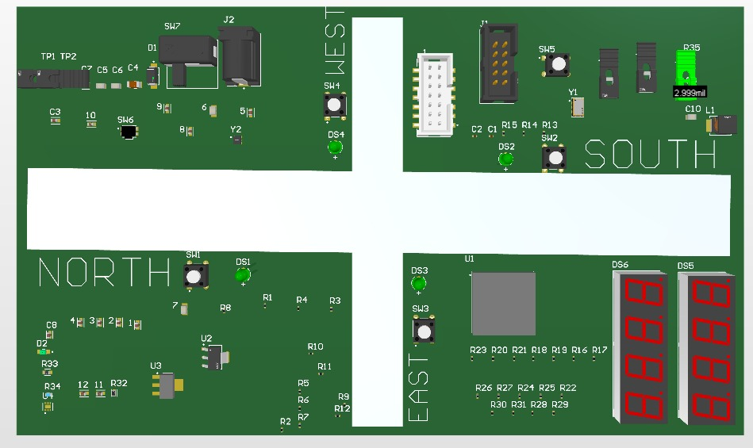

HARDWARE EXTENSION
3D PCB Layout Concept
Direction-Labeled Layout
Request switches and grant LEDs placed next to their direction labels (N/S/E/W).
FPGA, power input, and JTAG connector placed centrally for accessible testing.
Seven-segment displays positioned for clear visual debugging.
Concept-level only — not yet manufactured or electrically tested.
14

Slide 15
RESULTS
Requirement Validation Summary
Requirement | Status | Evidence
Main-road priority | Passed | QuestaSim waveform
Side-road service | Passed | FSM and countdown waveform
No conflicting grants | Passed | State-based grant logic
FPGA implementation | Passed | Nexys A7 demonstration
Schematic design | Completed | Altium schematic sheets
PCB concept | Completed | 3D PCB view
4 / 4
6 / 6
0
Functional requirements passed in simulation
Test cases executed without a safety violation
Conflicting main/side grants observed
15

Slide 16
CONCLUSION & OUTLOOK
A Complete Hardware Design Workflow
A deterministic FPGA-based RSU controller was designed, simulated, and demonstrated on real hardware, with the safety invariant enforced by construction and confirmed in QuestaSim.
The schematic and PCB concept in Altium chart a credible path toward dedicated controller hardware.
Thank You
Questions & Discussion
Future Work
Turning movements & emergency-vehicle priority
Wireless V2X communication (IEEE 802.11p)
Formal verification of the safety property
PCB manufacturing & electrical testing
16

